Slide 1

6th Grade Math
Unit 6, Lesson 8 Digging Deeper into Unit Rates Volume 1, pg. 292

Slide 2


Benchmarks
MA.6.AR.3.2
Given a real-world context, determine a rate for a ratio of quantities with different units. Calculate and interpret the corresponding unit rate.
MA.6.AR.3.5
Solve mathematical and real-world problems involving ratios, rates, and unit rates, including comparisons, mixtures, ratios of lengths and conversions within the same measurement system.
volume 1, pg. 292

Slide 3
Integrated Mathematical Thinking and Reasoning Standards
MA.K12.MTR.2.1 Demonstrate understanding by representing problems in multiple ways.
MA.K12.MTR.7.1 Apply mathematics to real-world contexts.
volume 1, pg. 292

Slide 4

Learning Targets
I can determine a unit rate when given different ratios.
I can interpret unit rates in real-world contexts.
I can use unit rates to solve problems.
volume 1, pg. 292

Slide 5

Warm-Up
volume 1, pg. 292

Slide 6
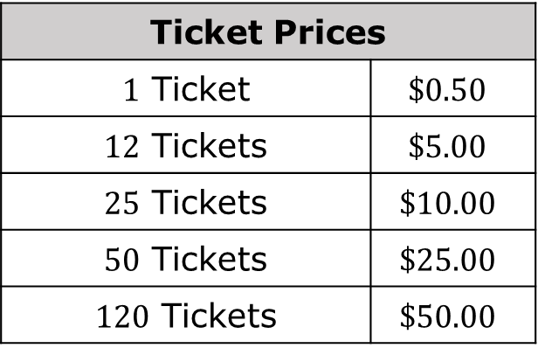
6.8.1 Warm-Up: Ticket Booth
At a local fall festival, the following prices are shown at the ticket booth.
Without performing any calculations, explain which option you think would be the best.
Ticket Prices
$1$ Ticket | $$\$0.50$$
$12$ Tickets | $$\$5.00$$
$25$ Tickets | $$\$10.00$$
$50$ Tickets | $$\$25.00$$
$120$ Tickets | $$\$50.00$$
volume 1, pg. 292

Slide 7
Determine a pair of ratios, tickets:price, that appear to be equivalent. Write them in the space below.
If it is not possible to determine a pair of equivalent ratios from the sign, select one ratio and write another one that is equivalent.
___ ticket(s) : $______
___ ticket(s) : $______
By what factor can both values in the first ratio be multiplied to find the second ratio?
volume 1, pg. 292

Slide 8

Guided Instruction
volume 1, pg. 293

Slide 9
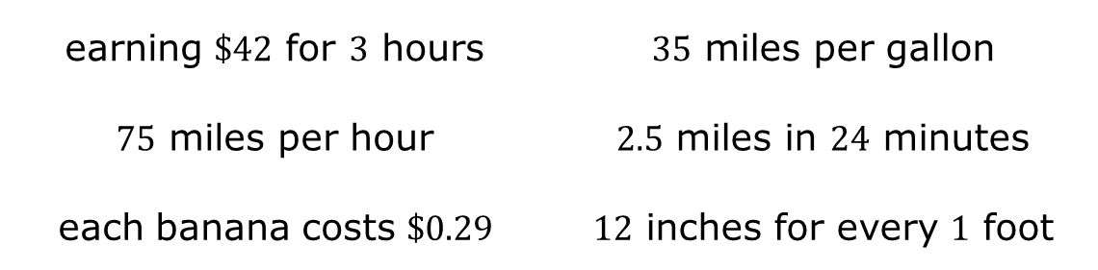
6.8.2 Guided Instruction: Interpreting Unit Rate
A unit rate is a ratio comparing a number of units of a quantity to ___ unit of another quantity.
Several rates are listed. Circle those that represent a unit rate.
earning $\$42$ for $3$ hours | $35$ miles per gallon
$75$ miles per hour | $2.5$ miles in $24$ minutes
each banana costs $\$0.29$ | $12$ inches for every $1$ foot
volume 1, pg. 293

Slide 10
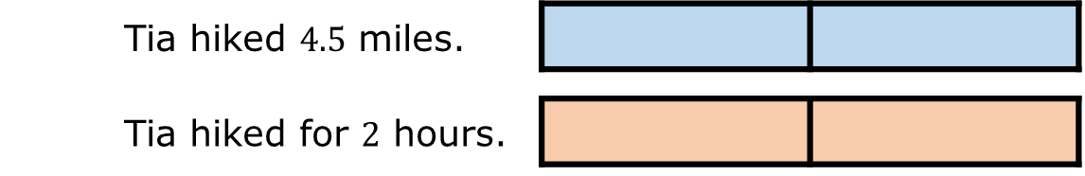
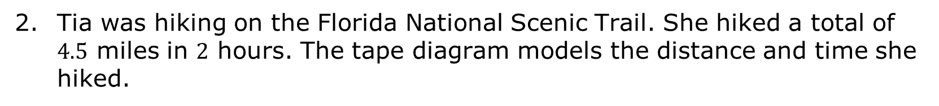
Tia was hiking on the Florida National Scenic Trail. She hiked a total of $4.5$ miles in $2$ hours. The tape diagram models the distance and time she hiked.
Tia hiked $4.5$ miles.
Tia hiked for $2$ hours.
Notice that each tape diagram is the same size because it represents quantities in the same situation.
Fill in each box of the tape diagram to show the value it represents.
volume 1, pg. 293

Slide 11

What is Tia’s unit rate in miles per hour?
Draw a tape diagram that represents the time it would take Tia to hike $9$ miles on the trail at this pace.
volume 1, pg. 293

Slide 12
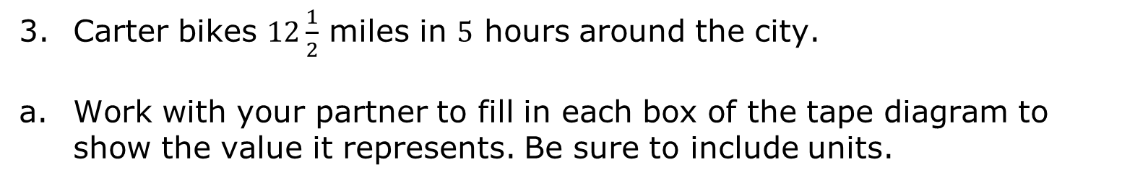
Carter bikes $12\frac{1}{2}$ miles in $5$ hours around the city.
Work with your partner to fill in each box of the tape diagram to show the value it represents. Be sure to include units.
Interpret the unit rate for Carter’s bike ride. Include units.
volume 1, pg. 294

Slide 13
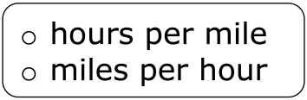
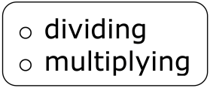
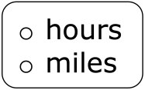
Explain which person is moving slower, Tia or Carter. Include the unit rates in your explanation.
Complete the statement.
In each scenario, the unit rate in can be determined by the number of traveled by the number of traveled.
volume 1, pg. 294

Slide 14

Guided Practice
volume 1, pg. 294

Slide 15

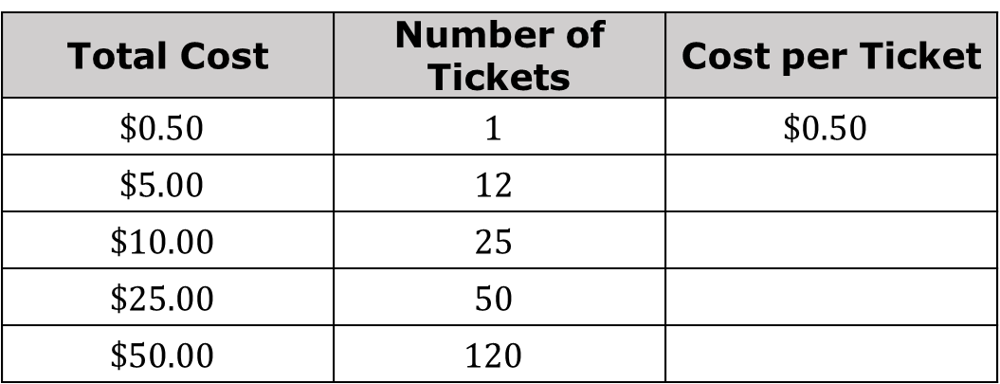
6.8.3 Guided Practice: Using Unit Rates to Solve Problems
Unit rates would be helpful in considering the ticket booth from the Warm-Up. Miguel set up the table shown to consider the costs per ticket for each advertised price.
Work with your partner to complete the table. Then, answer the questions that follow.
Total Cost | Number of Tickets | Cost per Ticket
$$\$0.50$$ | $$1$$ | $$\$0.50$$
$$\$5.00$$ | $$12$$
$$\$10.00$$ | $$25$$
$$\$25.00$$ | $$50$$
$$\$50.00$$ | $$120$$
volume 1, pg. 294

Slide 16
Using the unit rates, explain which ticket option(s) is(are) the best deal.
Using the unit rates, explain which ticket options are the same deal.
Compare your answer to the previous question to the equivalent ratios you determined in the Warm-Up. Make any revisions to your previous thinking, as necessary.
With your partner, discuss recommendations for how the high school should change its prices for carnival tickets.
volume 1, pg. 294

Slide 17
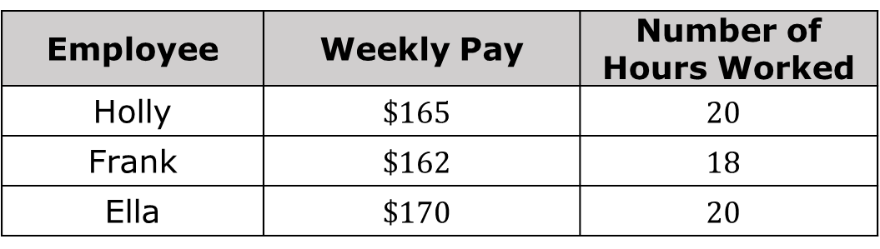
Holly, Frank, and Ella work part-time for Shoes-R-Us. The table shows how much money each person earns during a work week.
Employee | Weekly Pay | Number of Hours Worked
Holly | $$\$165$$ | $$20$$
Frank | $$\$162$$ | $$18$$
Ella | $$\$170$$ | $$20$$
Work with your partner to answer the following questions using the information in the table.
Find and interpret the hourly rate Holly earns.
volume 1, pg. 295

Slide 18

Which employee earns the higher hourly rate, Ella or Frank?
If Frank works $25$ hours next week, how much should he expect to earn?
volume 1, pg. 295

Slide 19

Collaboration
volume 1, pg. 295

Slide 20
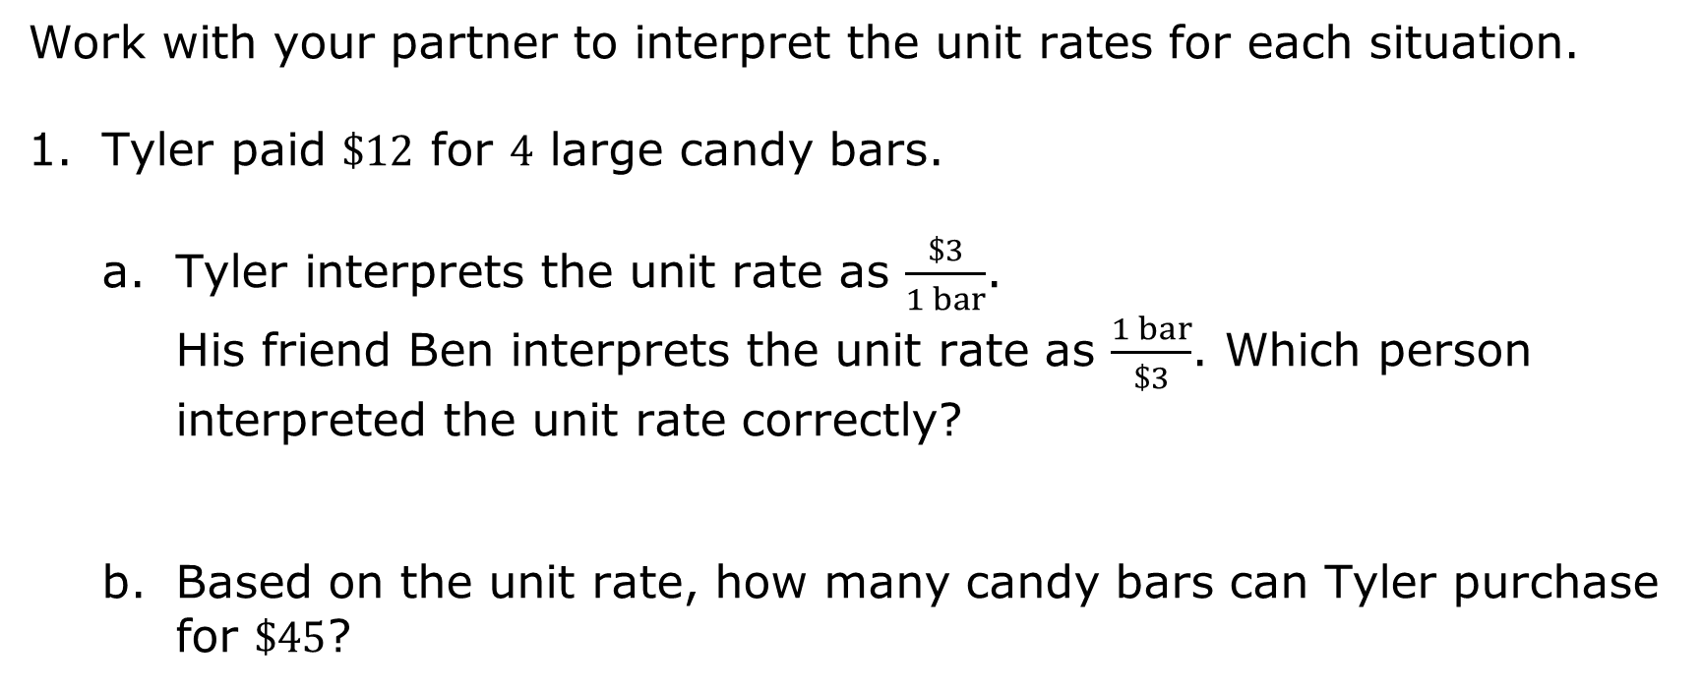
6.8.4 Collaboration: Using and Interpreting Unit Rates
Work with your partner to interpret the unit rates for each situation.
Tyler paid $\$12$ for $4$ large candy bars.
Tyler interprets the unit rate as $\frac{\$3}{1 bar}$.
His friend Ben interprets the unit rate as $\frac{1 bar}{\$3}$. Which person interpreted the unit rate correctly?
Based on the unit rate, how many candy bars can Tyler purchase for $\$45$?
volume 1, pg. 295

Slide 21
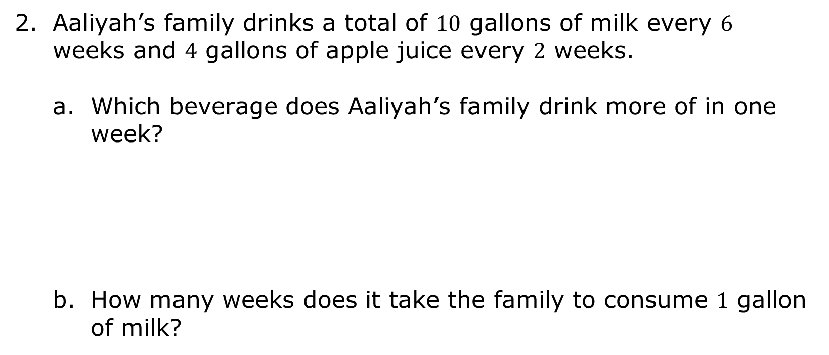
Aaliyah’s family drinks a total of $10$ gallons of milk every $6$ weeks and $4$ gallons of apple juice every $2$ weeks.
Which beverage does Aaliyah’s family drink more of in one week?
How many weeks does it take the family to consume $1$ gallon of milk?
volume 1, pg. 295

Slide 22
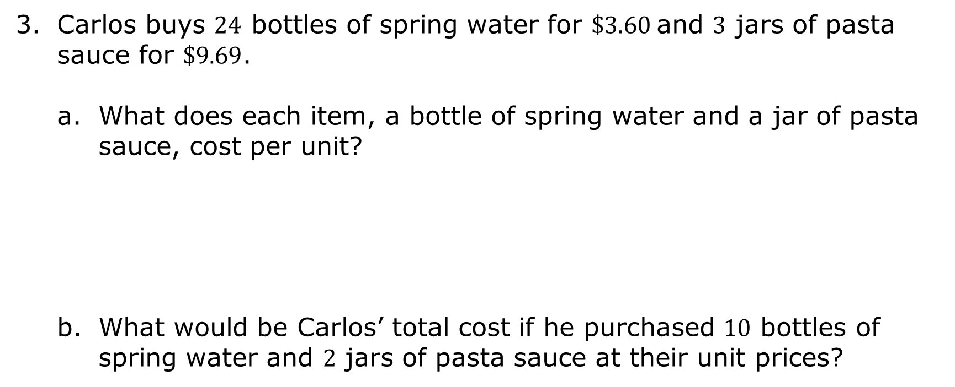
Carlos buys $24$ bottles of spring water for $\$3.60$and $3$ jars of pasta sauce for $\$9.69$.
What does each item, a bottle of spring water and a jar of pasta sauce, cost per unit?
What would be Carlos’ total cost if he purchased $10$ bottles of spring water and $2$ jars of pasta sauce at their unit prices?
volume 1, pg. 296

Slide 23

Bring It Together
volume 1, pg. 296

Slide 24
6.8.5 Bring It Together: Interpreting Unit Rates
Work with your partner to write three statements to summarize your learning about unit rates from today’s lesson.
volume 1, pg. 296

Slide 25

Wrap-Up
volume 1, pg. 296

Slide 26
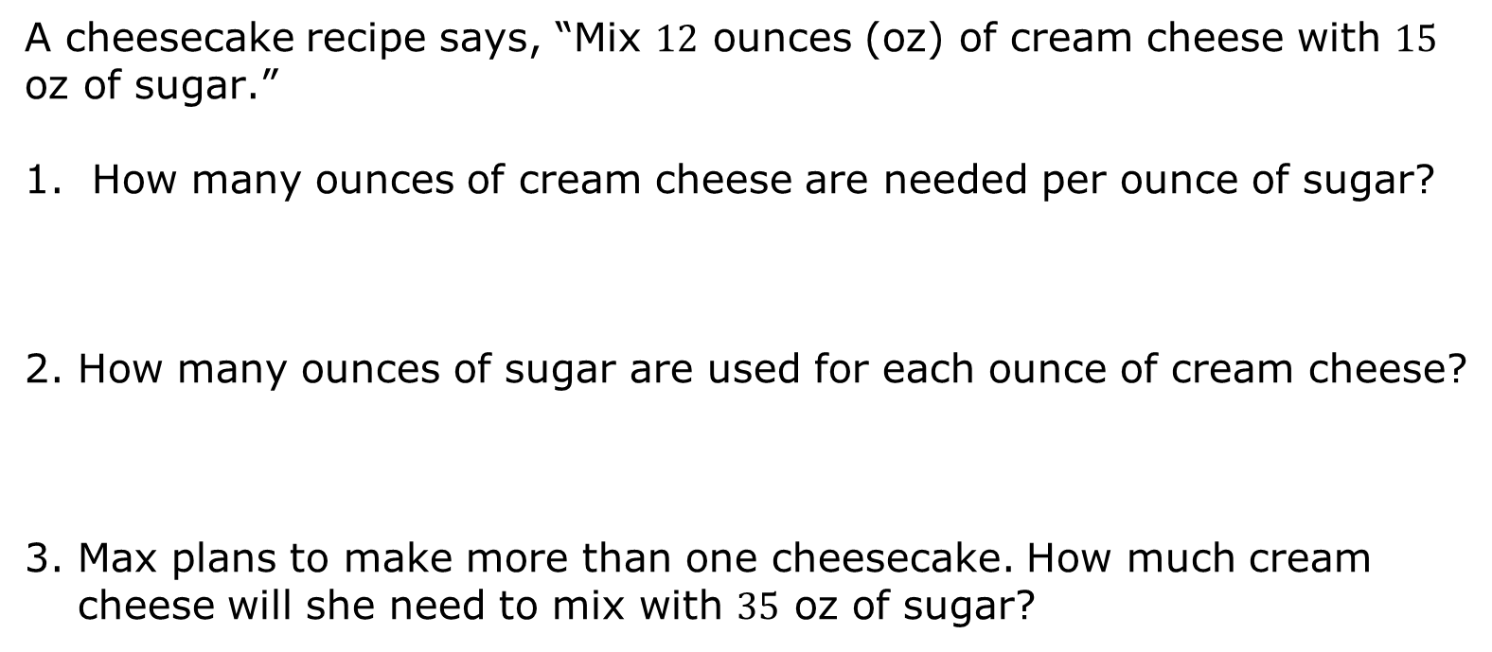
6.8.6 Wrap-Up: Ticket Out the Door
A cheesecake recipe says, “Mix $12$ ounces (oz) of cream cheese with $15$ oz of sugar.”
How many ounces of cream cheese are needed per ounce of sugar?
How many ounces of sugar are used for each ounce of cream cheese?
Max plans to make more than one cheesecake. How much cream cheese will she need to mix with $35$ oz of sugar?
volume 1, pg. 296

